Slide 1



Project Capstone 2024
THE IOT SYSTEM FOR ELEMENTARY STUDENT
ATTENDANCE ON SCHOOL BUSES SUPPORTS
MONITORING AND NOTIFYING TO PARENTS AND TEACHER
IOP490_G1
Mai Van Tung
Vu Duy Hanh
Luu Minh Huong
Khuat Duc Anh
Team member
Supervisor

Slide 2

CONTENT
1
Overview
Hardware design
Circuit
Firmware
2
3
Software design
Cloud database
Mobile application
4
Demo devices & Future goals
5
Demo & QA

Slide 3


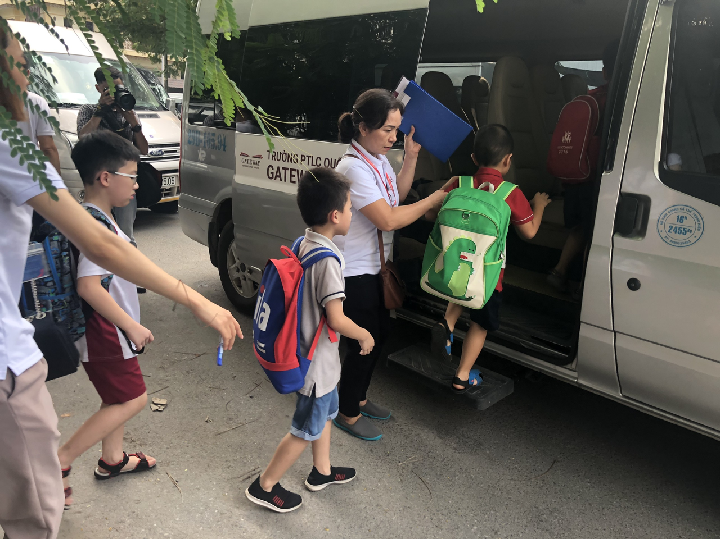
OVERVIEW
Nowadays, it's common for students, especially elementary, to use school buses for transportation.
Nearly one-third of parents said they would consider sending their child to a different school if transportation was provided. [1]
Both families and schools are keen on following their children's travel
[1] https://www.hopskipdrive.com/blog/parents-weigh-in-on-school-transportation-today

Slide 4
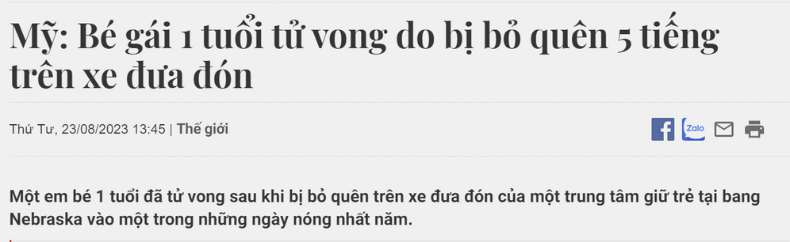
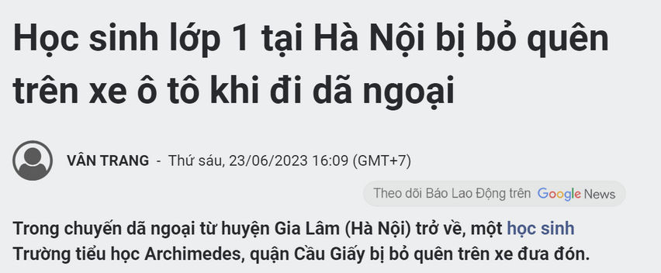
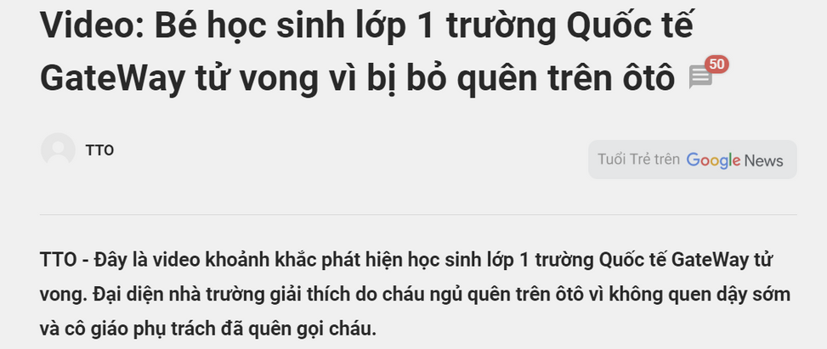
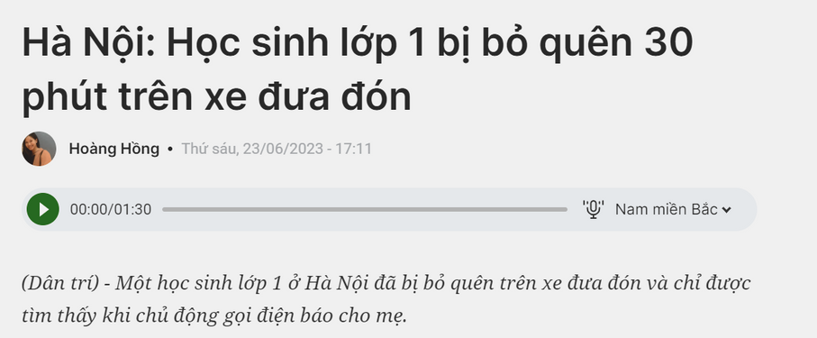
OVERVIEW
In many cases, children have been left behind on the bus...
https://baotintuc.vn/the-gioi/my-be-gai-1-tuoi-tu-vong-do-bi-bo-quen-5-tieng-tren-xe-dua-don-20230823112531856.htm
https://dantri.com.vn/giao-duc/ha-noi-hoc-sinh-lop-1-bi-bo-quen-30-phut-tren-xe-dua-don-20230623170550658.htm
https://laodong.vn/giao-duc/hoc-sinh-lop-1-tai-ha-noi-bi-bo-quen-tren-xe-o-to-khi-di-da-ngoai-1208148.ldo
https://tuoitre.vn/video-khoanh-khac-phat-hien-hoc-sinh-lop-1-truong-quoc-te-gateway-tu-vong-20190807005220187.htm

Slide 5
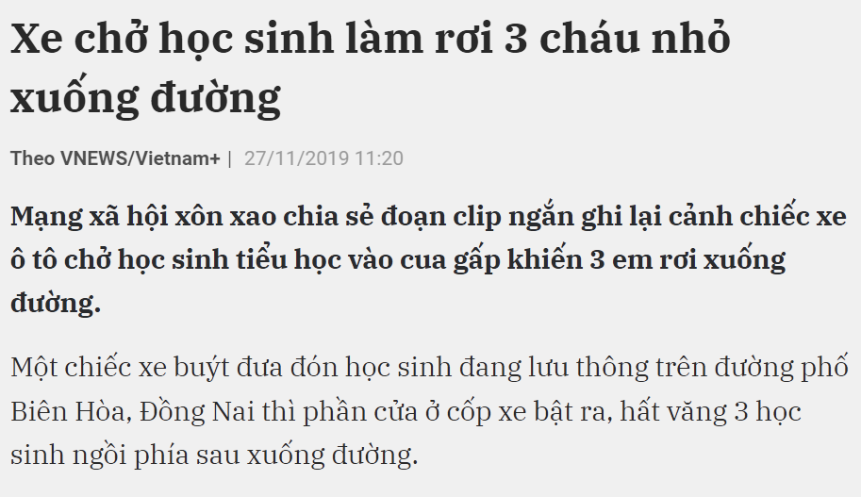

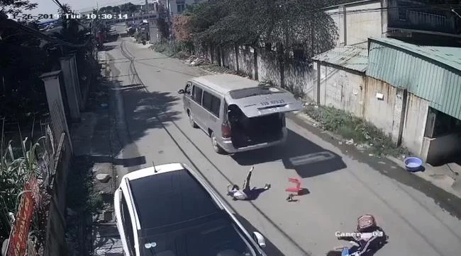



OVERVIEW
Taking attendance and monitoring bus journeys is very important and necessary
https://hanoimoi.vn/xe-cho-hoc-sinh-lam-roi-3-chau-nho-xuong-duong-528318.html

Slide 6

OVERVIEW
The school provides bus service in two forms: On-site and At-home.
The teacher checks attendance on the list written on paper
When student got down, teacher took attendance again
Usually the school rents buses from a third party
Some schools have mobile apps that support tracking school journeys

Slide 7
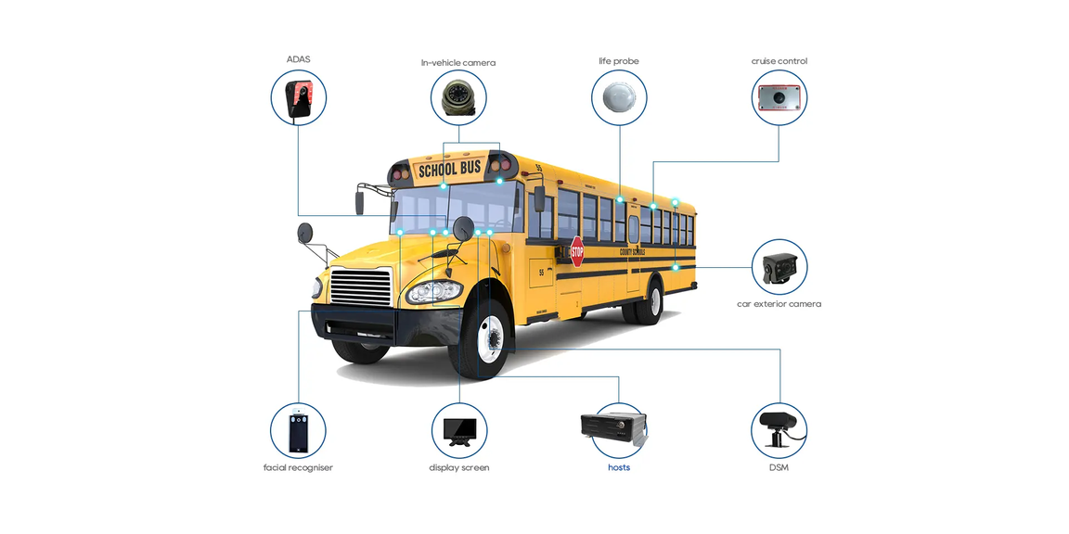
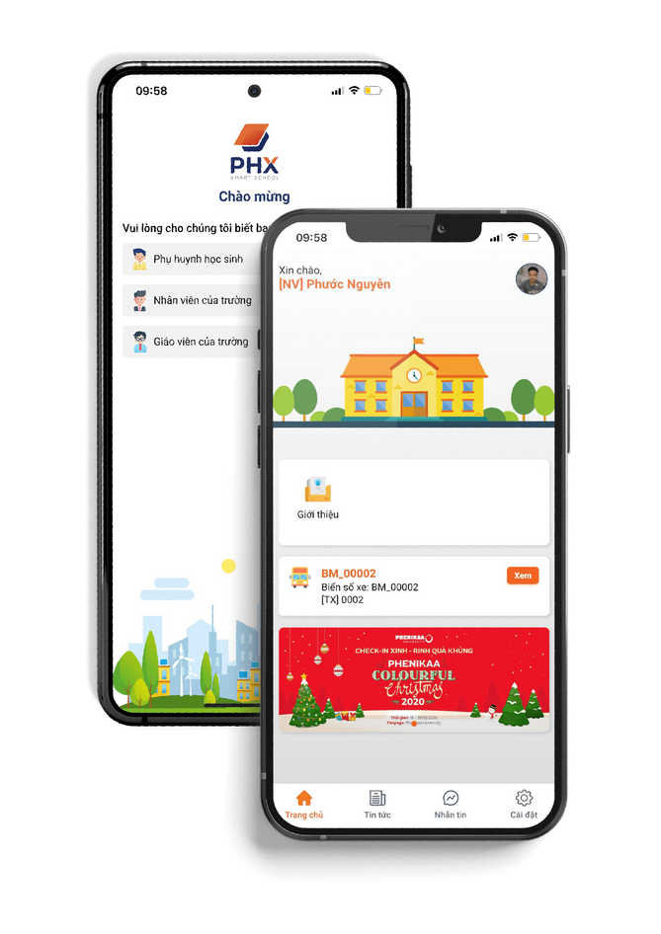
OVERVIEW
OVERVIEW
In China, a solution for tracking children going to school called the "School Bus GPS Tracking System" [6]
In Vietnam, attendance systems on school buses are also being implemented as PHX Smart School solution [7]
[6] https://en.yuweitek.com/school-bus-gps-tracking-system.html
[7] https://www.phx-smartschool.com/trien-khai-giai-phap-dua-don-hoc-sinh-theo-thoi-gian-thuc/

Slide 8

OVERVIEW
OVERVIEW
Manual attendance with paper
Supervising teachers have difficulty recognizing students' faces
Lack of immediate notification
Buses are not fixed

Slide 9
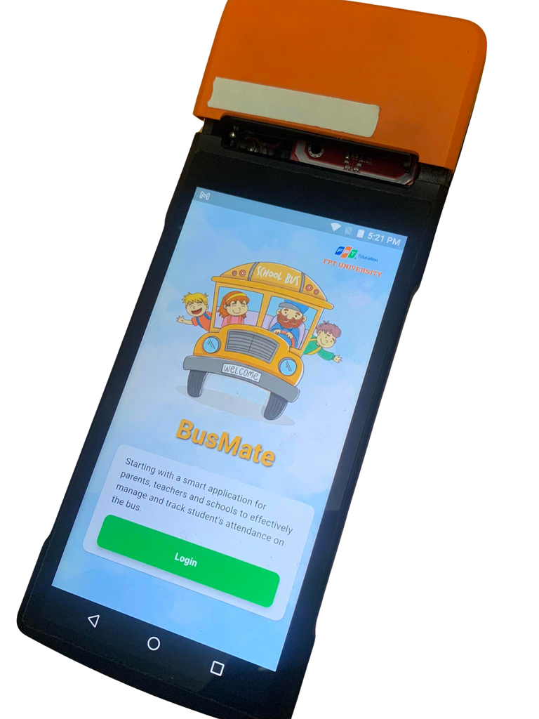

OBJECTIVES
1
Monitorization and notification for parents and teachers
2
Mobile Black Box
3
Mobile applications for multi-platforms
4
Attendance scanner using RFID, Biometric, Bluetooth technology

Slide 10
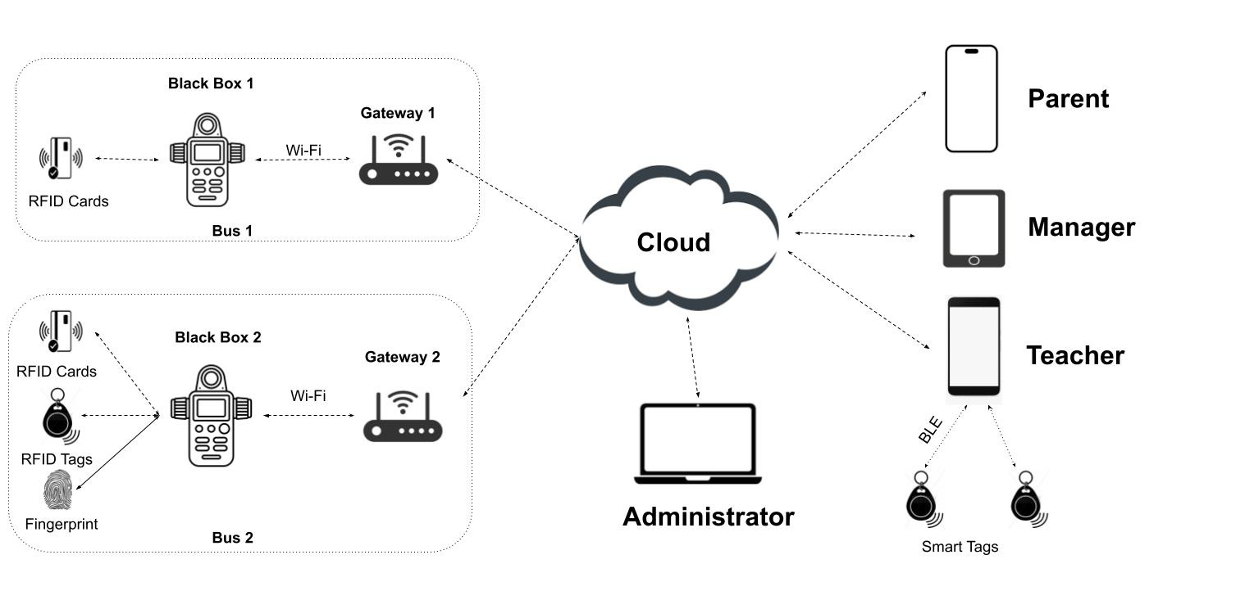
SYSTEM ARCHITECTURE

Slide 11

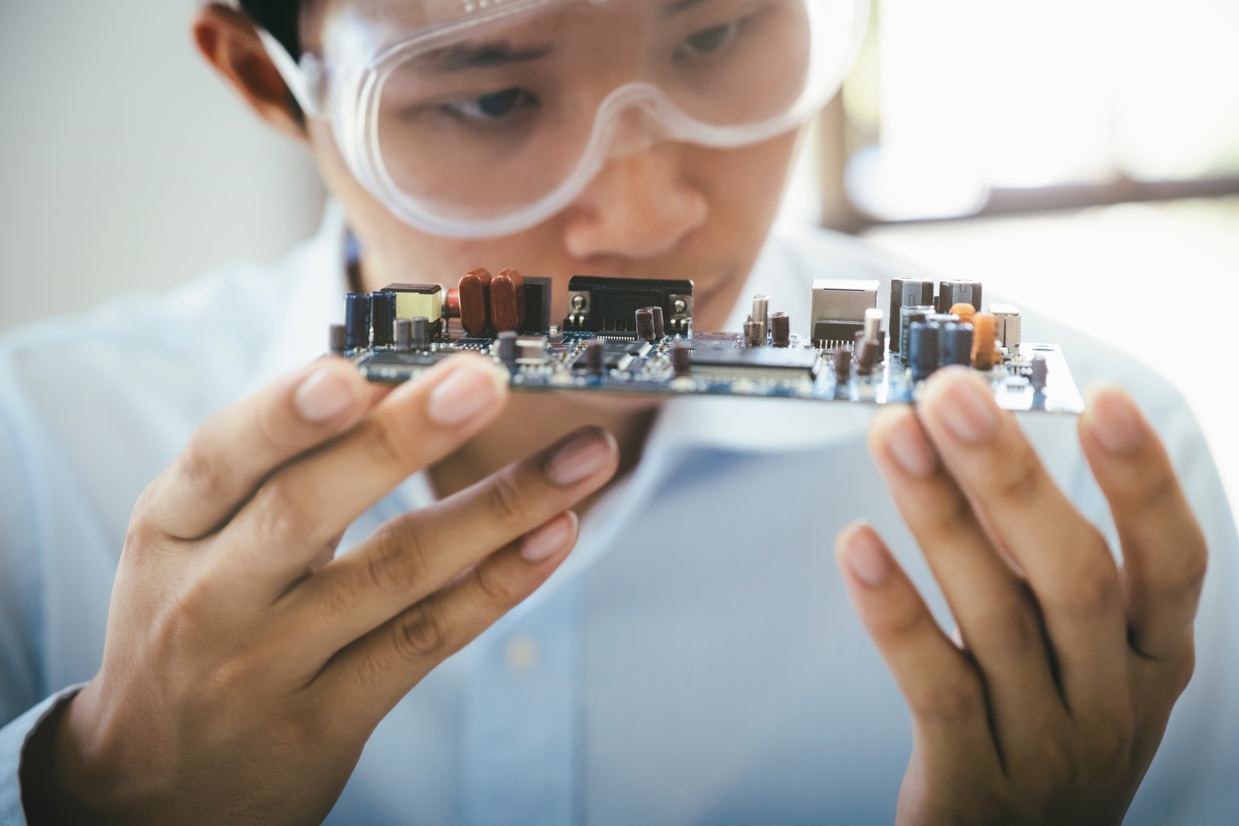
DEVICE REQUIREMENT
HARDWARE
Module can authenticate users
Small, convenience, flexible
Connect with wifi, bluetooth
Competitive price, easy to buy
Wide support community

Slide 12
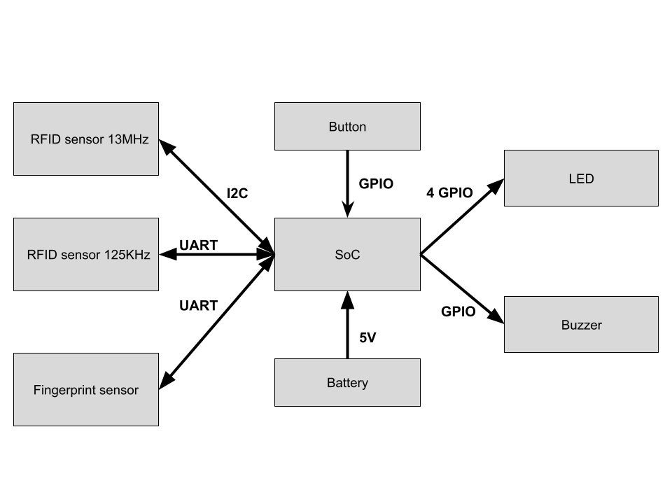
DEVICE STRUCTURE

Slide 13
RFID MODULE COMPARISON
Criteria | PN532 | HZ1050 | RC522 | D-T01
Operating frequency | 13.56 MHz | 125 kHz | 13.56 MHz | 125 kHz
Communicate | I2C, SPI, UART | UART, Wiegand | SPI | UART, Wiegand
Reading distance | 3 - 7 cm | 3 - 10 cm | 3 - 5 cm | 3 - 10 cm
Size | 40mm x 60mm | 36mm x 36mm | 40mm x 60mm | 38.5mm x 19mm x 9mm
NFC support | Yes | No | No | No

Slide 14
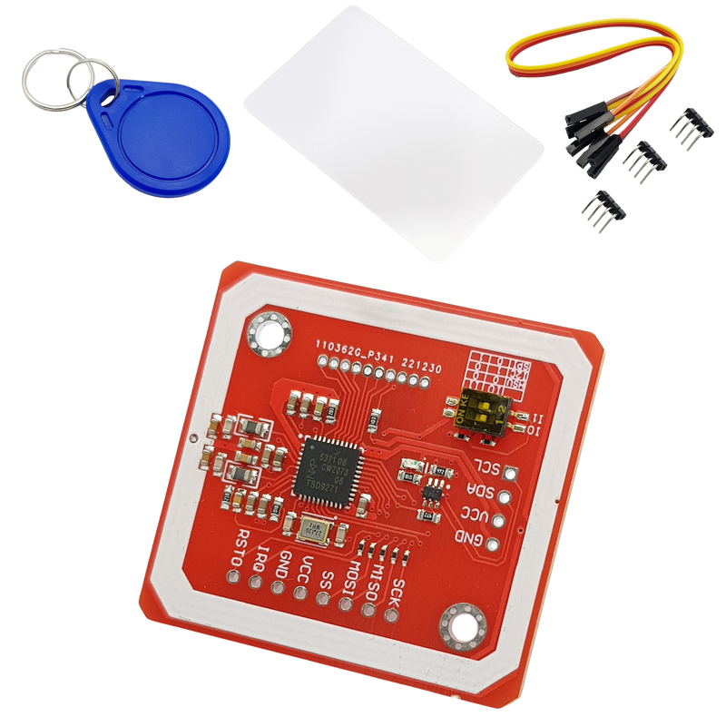
RFID 13.56MHZ READER
Power used: 2.7~5.5VDC
Communication standard:
I2C: TTL 3.3~5VDC
UART: TTL 3.3~5VDC
SPI: TTL 3.3VDC
Support reading/writing RFID NFC card standards
4 : 6
Customer Loyalty Percentage Level
Branding Exposure
Effectivity Level
96%
92%
IOT Tools Vs AI Tools
Used Ratio

Slide 15
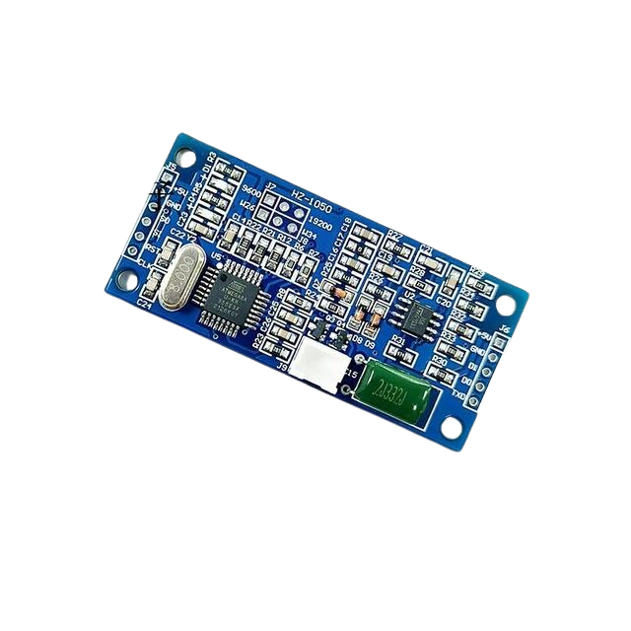
RFID 125KHZ READER
Only reads ID cards (EM4100, 4001,..
Frequency: 125KHz
Reading distance: 3-10cm
Reading time: <0.2s
Power: 3.3 - 5V
Dimensions: 29*62mm

Slide 16
Criteria | Hi-Link FPM383C | FPC1020A | AS608
Sensor type | Capacitance | Capacitance | optics
Fingerprint storage capacity | 60 | 80 | 150
Recognition speed | < 0.4 seconds | 0.00~400ms | < 0.45 seconds
False Recognition Rate (FAR) | < 0.001% | < 0.0001% | < 0.0001%
Product price | 185,000₫ | 445,000₫ | 249,000
FINGERPRINT COMPARISON

Slide 17
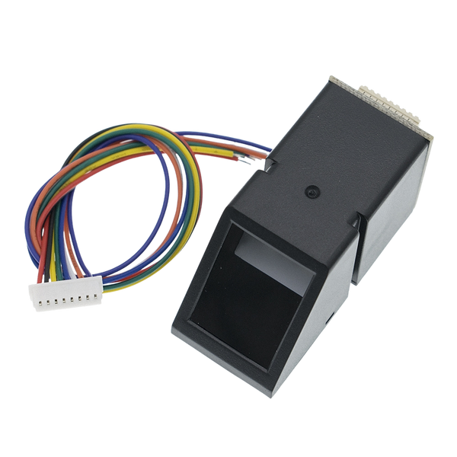
FINGERPRINT SENSOR
Operating voltage: 3.6 to 6.0VDC
Current consumption: <120mA
Communication method: UART Security
False acceptance rate (FAR): <0.001% (security level 3)
Rejection rate false (FRR): <1.0% (security level 3)
Can store more than 127 different fingerprints

Slide 18
SOC COMPARISON
Criteria | ESP32 | ESP8266CP2102 | ATmega328P
Price | 135,000 | 81,000 | 140,000₫
Communication | UART/GPIO/ADC/PWM/I2C/I2S/SPI | UART/I2C/SPI/GPIO | UART/I2C/SPI/GPIO/..
Wireless Connection | Wi-Fi, Bluetooth | Wi-Fi | Wi-Fi
Size | 48.2 x 25.4 x 12.9mm | 50 x 25 mm | 68.6 x 53.4 mm
Voltage | 5VDC | 5VDC | 5VDC

Slide 19

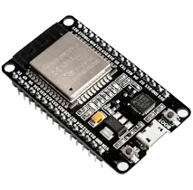
ESP32
Advantages of ESP32 :
1. Powerful performance
2. Wide connectivity
3. Large memory
4. Integrates many features
5. High security
6. Competitive prices
7. Large support community

Slide 20
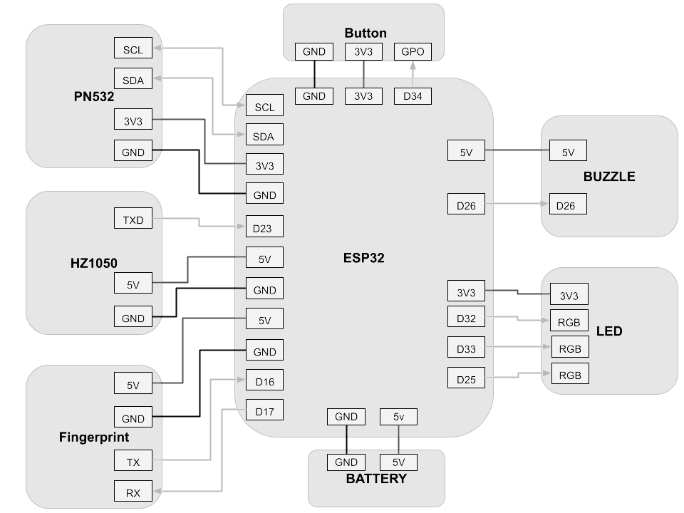
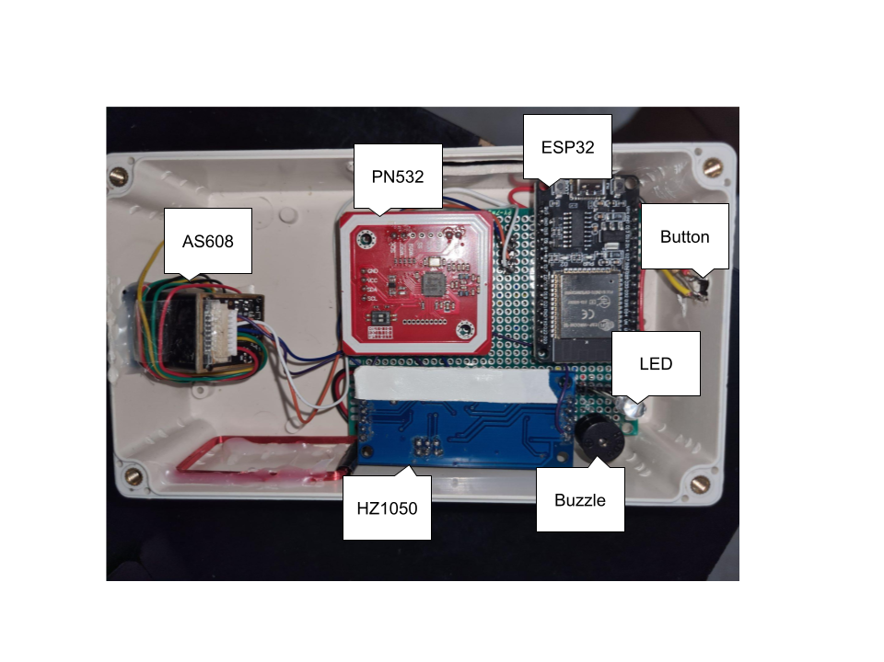
1ST PROTOTYPE

Slide 21
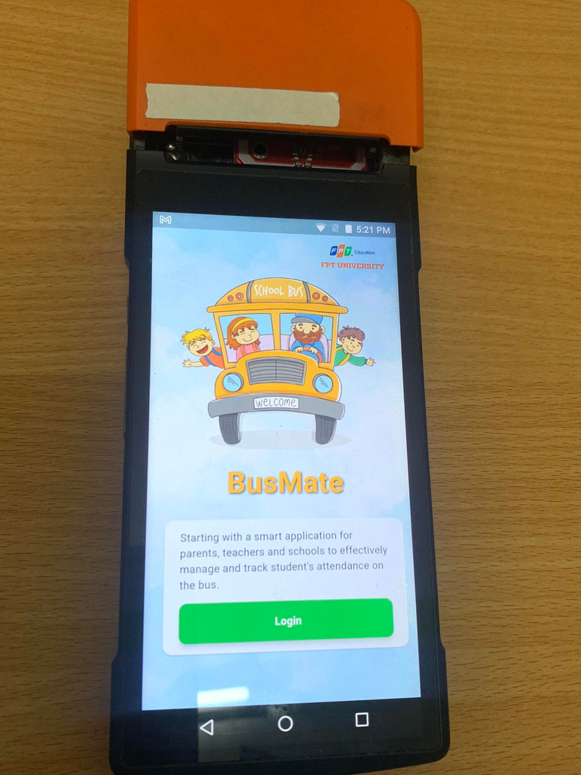
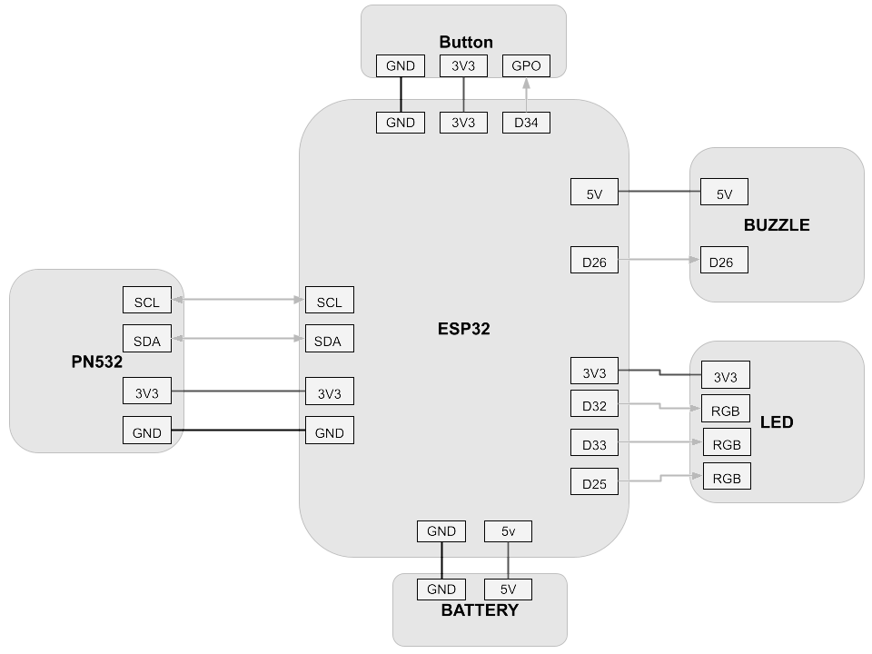
2ND PROTOTYPE

Slide 22
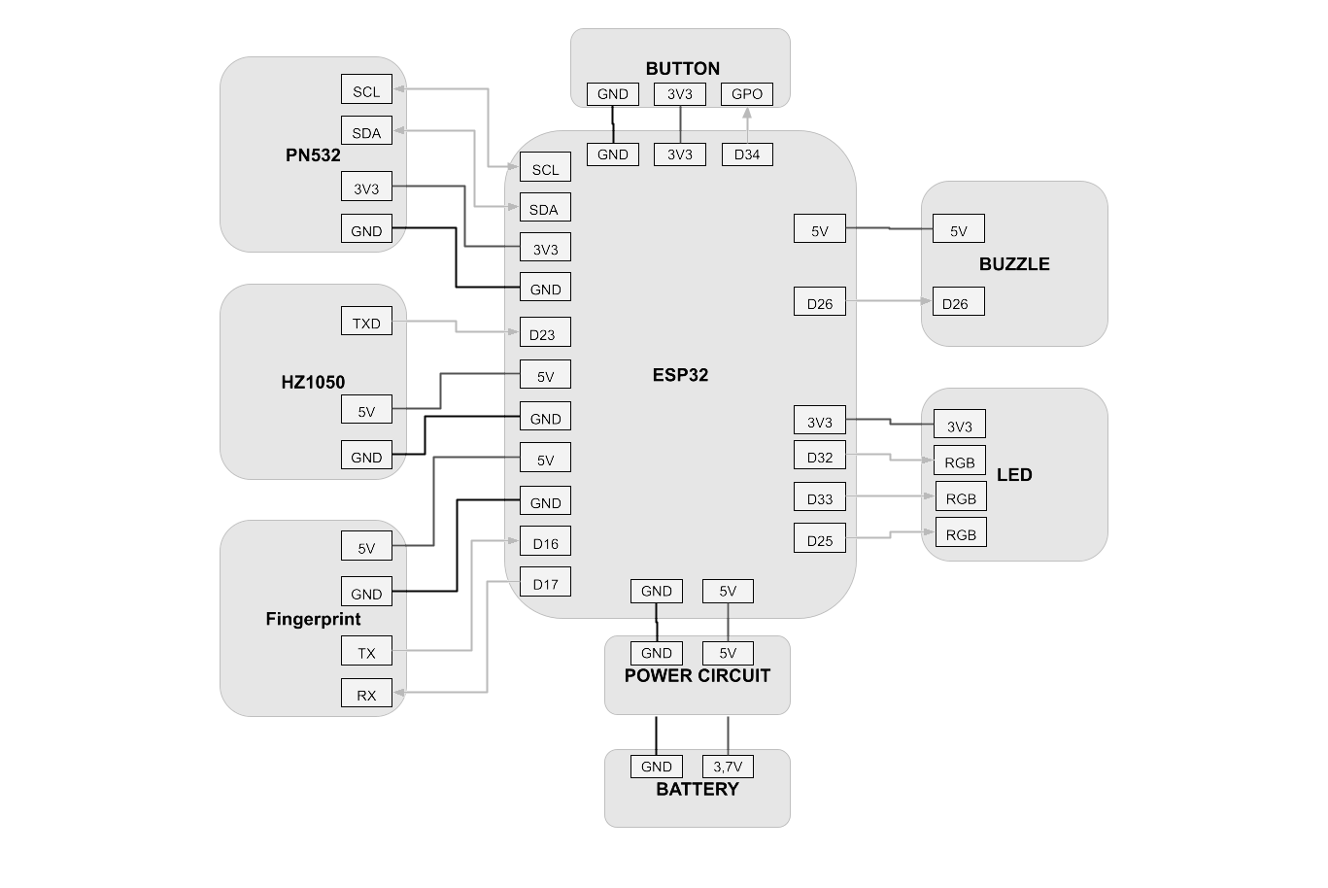
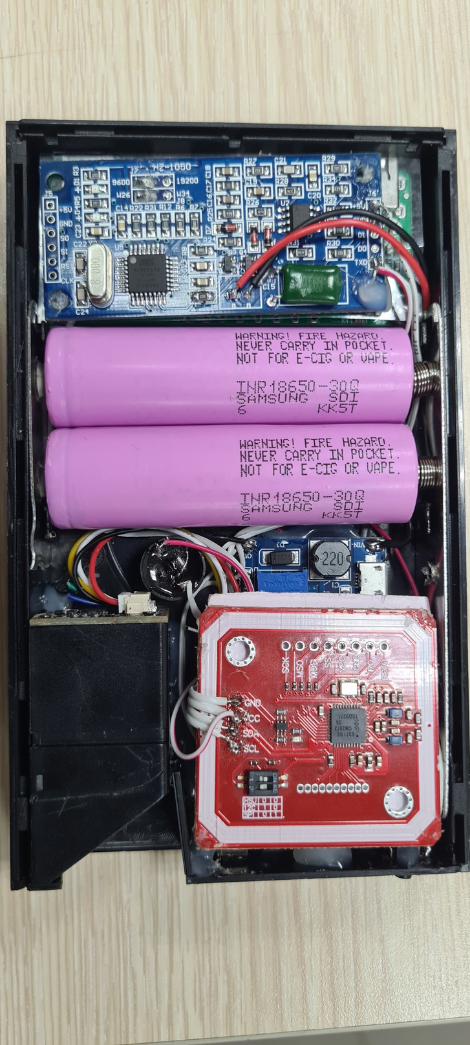
3RD PROTOTYPE

Slide 23

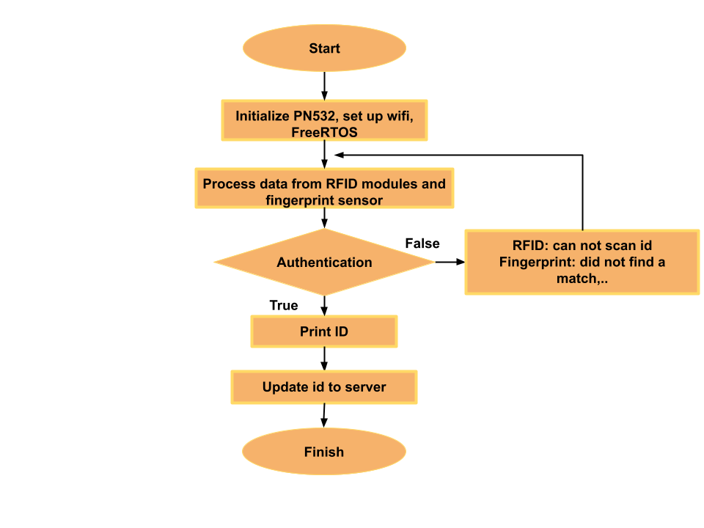
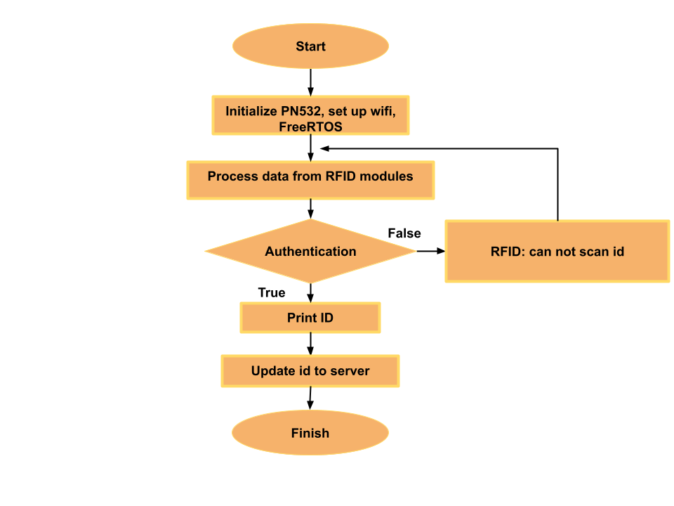
HARDWARE FLOW CHART
Prototype 1,3
Prototype 2

Slide 24

CLOUD DATABASE
MAIN FUNCTIONS OF
BUSMATE’S CLOUD
Data collection from black boxes
Data processing and storage
Communication with mobile application

Slide 25
CLOUD COMPARISON
Criteria | AWS | Google Cloud Platform | Microsoft Azure
Database services | Amazon RDS, DynamoDB | Cloud SQL | Azure SQL Database, Cosmos DB
Data Type | SQL and NoSQL | SQL and NoSQL | SQL and NoSQL
Pricing | $0.154/h | $0.166/h | $0.134/h

Slide 26



FIREBASE
Offers a real-time NoSQL database
Integrates smoothly with other Google services and popular frameworks
Provides robust authentication services
Scales effortlessly

Slide 27
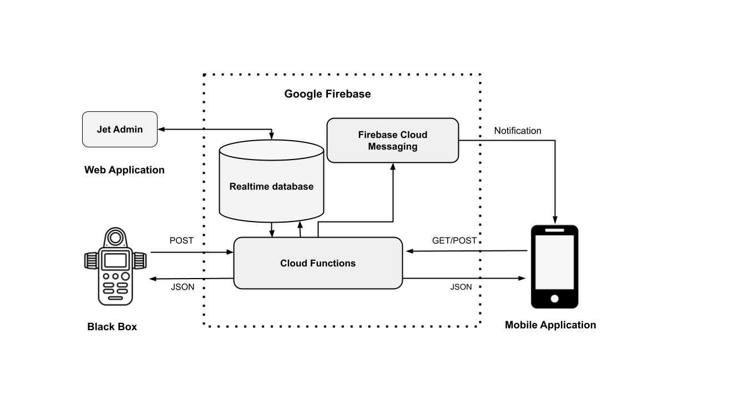
BUSMATE FIREBASE ARCHITECTURE
Data is stored in a real-time database
Black boxes and mobile applications send request data to Cloud functions
The mobile app receives notifications
Website for manager built by Jet Admin service linked to database

Slide 28
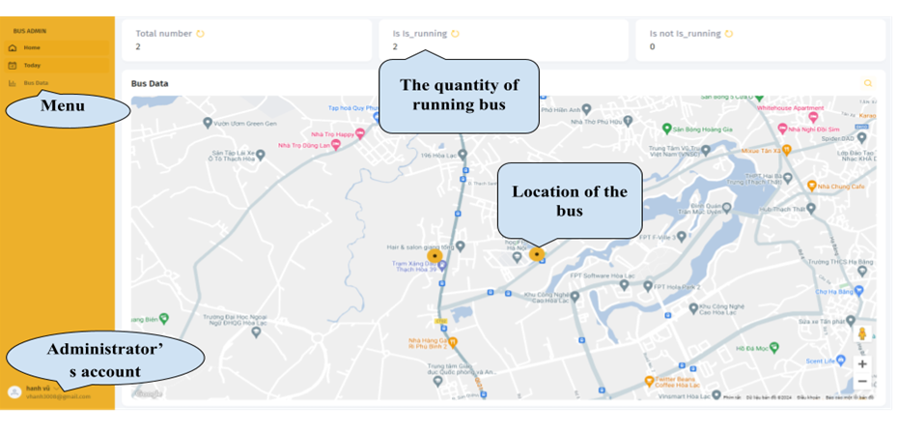
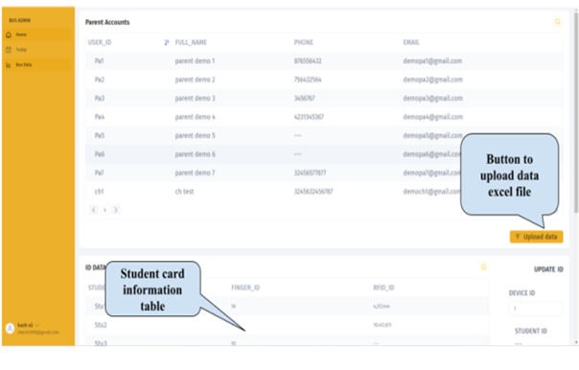
ADMIN WEBSITE
Today Screen
Bus Data Screen

Slide 29
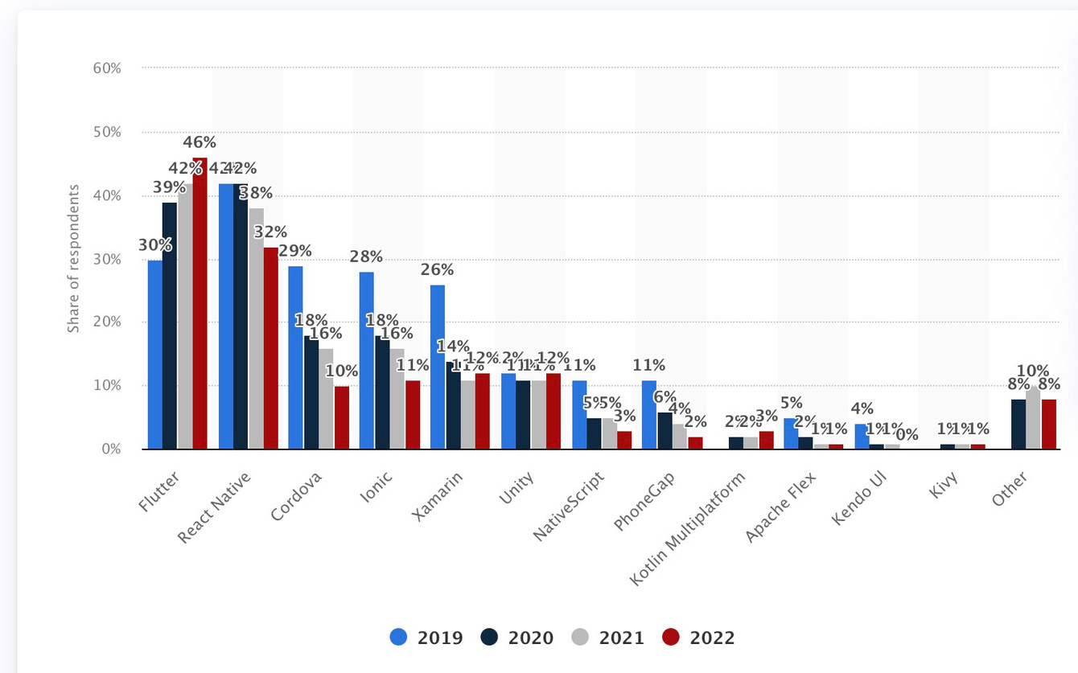
MOBILE APPLICATION
Survey statistics about Cross-platform mobile framework used by software developers worldwide from 2019-2022
https://www.brilworks.com/blog/cross-platform-app-development-best-frameworks/

Slide 30

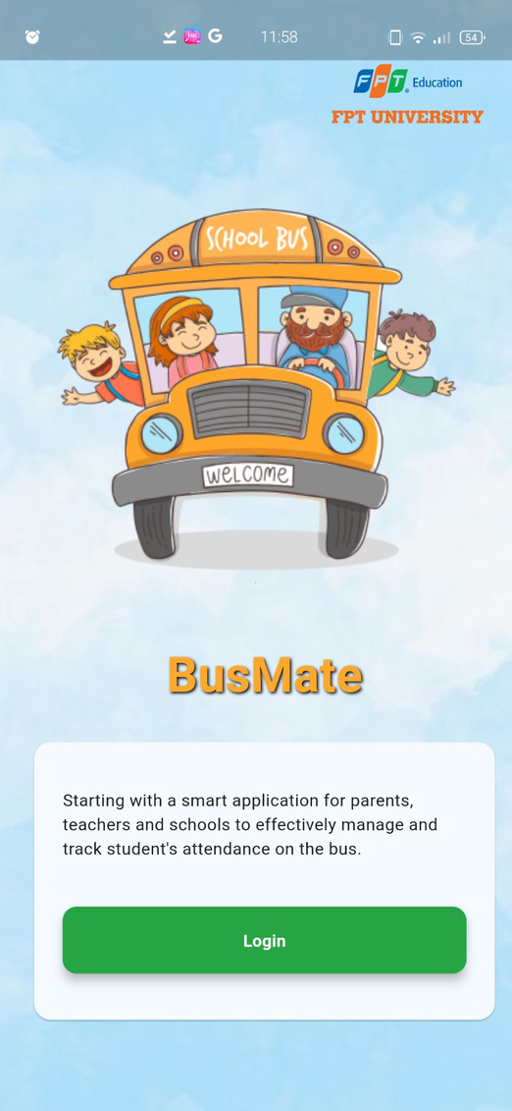
THREE ROLES
Teacher: process tasks related to student’s attendance
Parent: receive notifications and monitor children
Manager: manage all bus trips and process register tasks

Slide 31
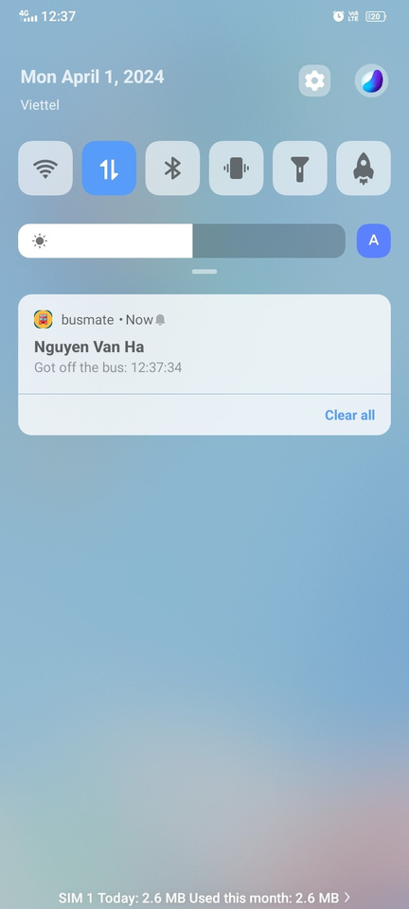
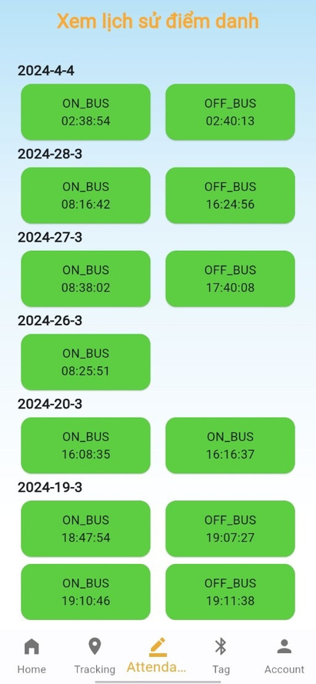
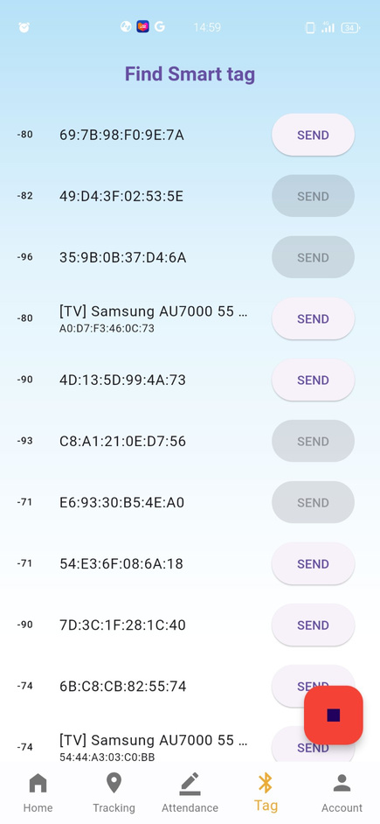
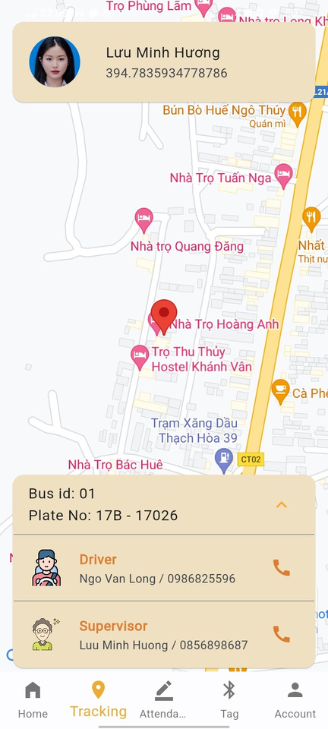
PARENT’S SCREEN
Receiving notifications
List attendance history
Register smart tag
Tracking GPS of bus

Slide 32
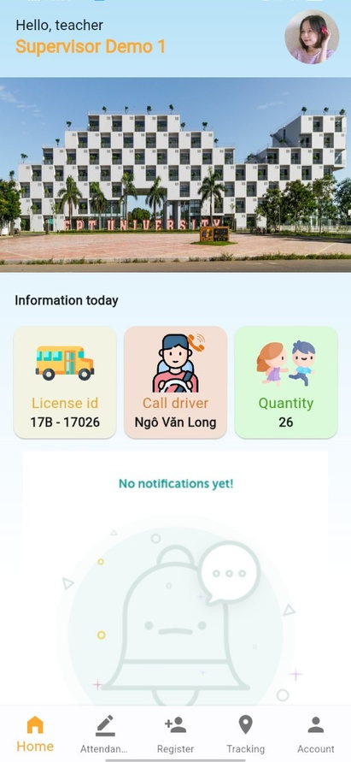
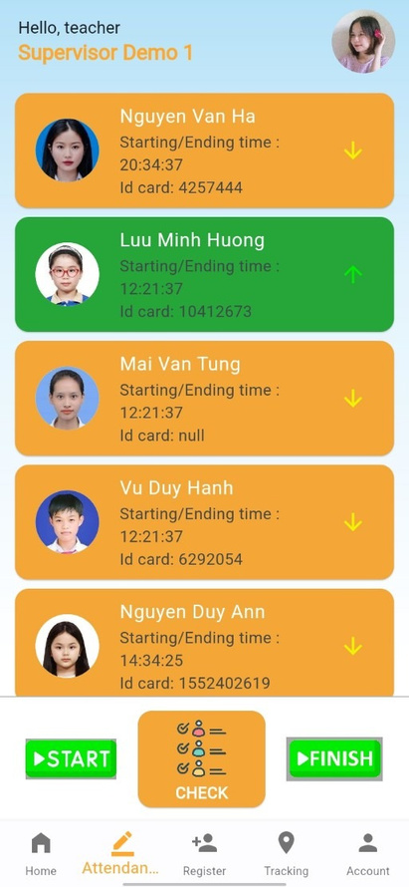
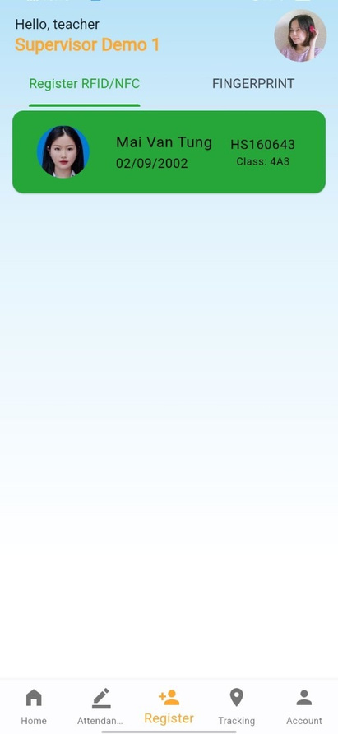
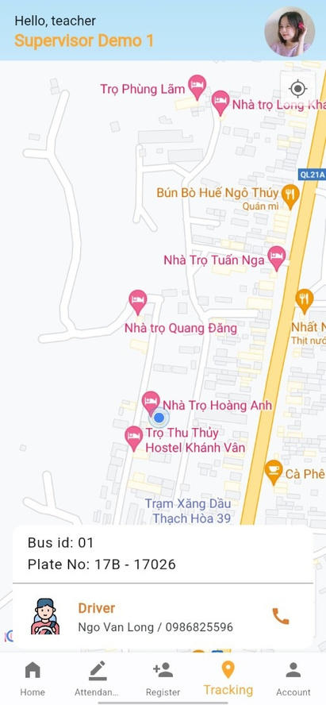
TEACHER’S SCREEN
Home Teacher
Taking attendance
Registering card/fingerprint
Send GPS of bus

Slide 33
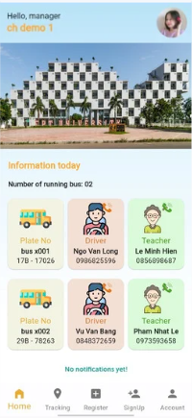
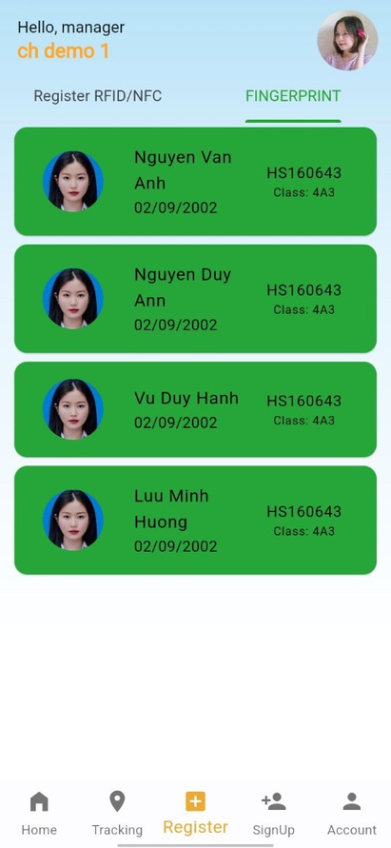
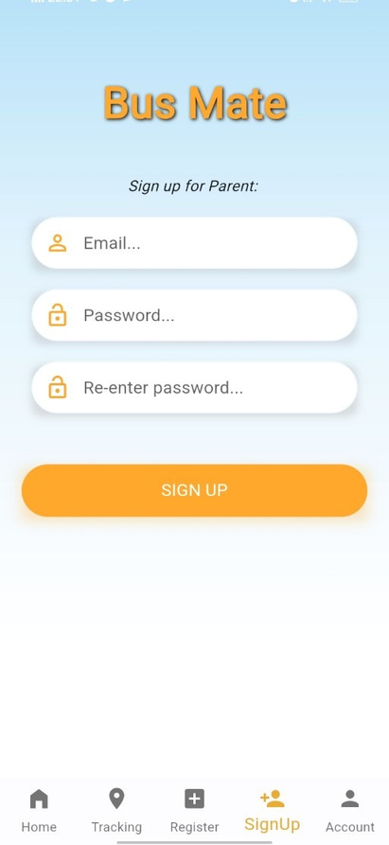
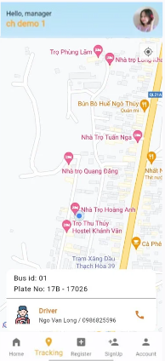
MANAGER’S SCREEN
Home Manager
Registering card/fingerprint
Signing-up
Tracking GPS of bus

Slide 34
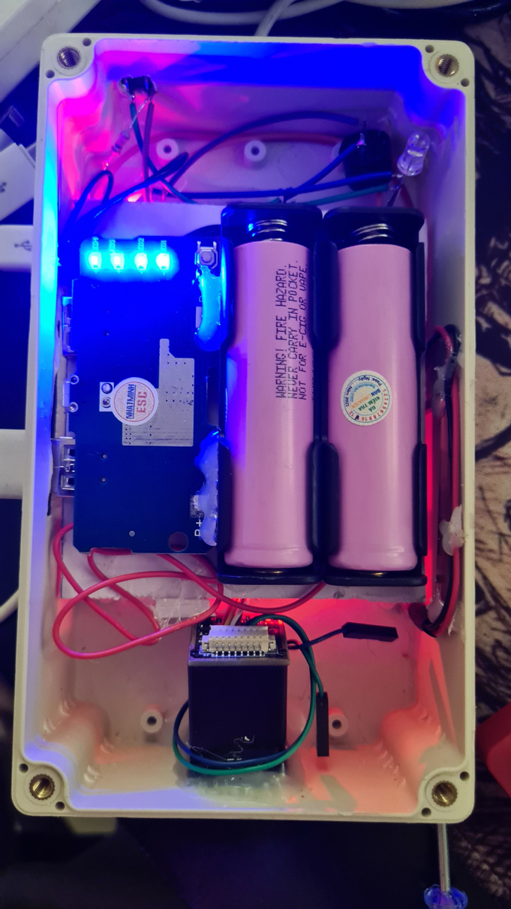
DEMO DEVICE
Prototype 1
Prototype 2
Prototype 3

Slide 35

FUTURE GOALS
Develop applications on iOS
Design, finish box and device
Develop a web application for administrator

Slide 36

DEMO
Q & A

Slide 37

Thank You

